Slide 1
Intermediate -- h-Drive

Slide 2
In these few PowerPoints we will work on some advanced, but useful drive train code: H-Drive, X-Drive, and mecanum-wheel-drive. There will be some vectors and directions involved but they are nothing scary.

Slide 3
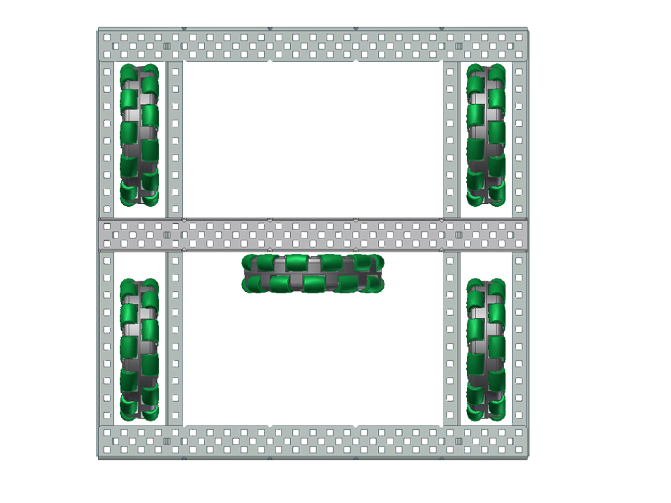
When I say “H-Drive”, I am referring to this type of rectangular drive base with a steering wheel in the middle.
The central wheel should not move when going back and forth, but should turn as the robot turn left and right. It can also be used to strafe the robot left and right.
Knowing what the motor does should be the basis of any code.

Slide 4
Depending on how the motor for the steering wheel is placed, you may need to reverse it.
The rule for reversing is always that you want the motor value to be positive when the mechanism is going in a positive direction (up, right, forward), and vice versa.
In this case, you want the wheel to go right when you move your joystick to the right.
1
Right joystick (channels 1 and 2)
2

Slide 5
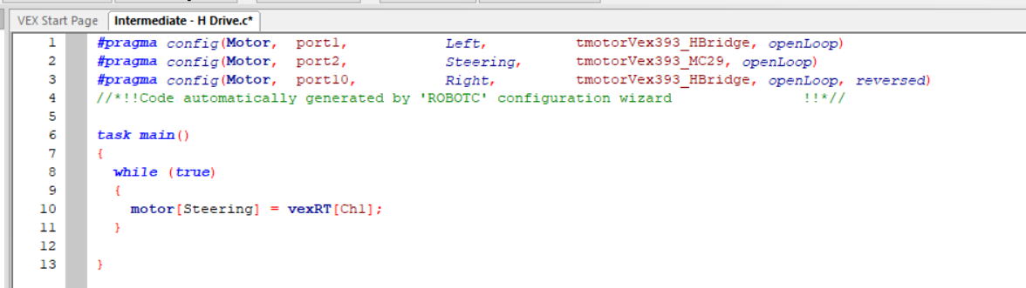
Here’s a basic testing code. It uses some of the basic logic mentioned in previous PowerPoints. It’s helpful to have only one motor running in your test code, so there are less variables to account for.
After testing, reverse the motor if the robot is moving left. You want to make sure all the motors are reversed properly before writing a ton of code. DO NOT touch the motor setup after this point.

Slide 6
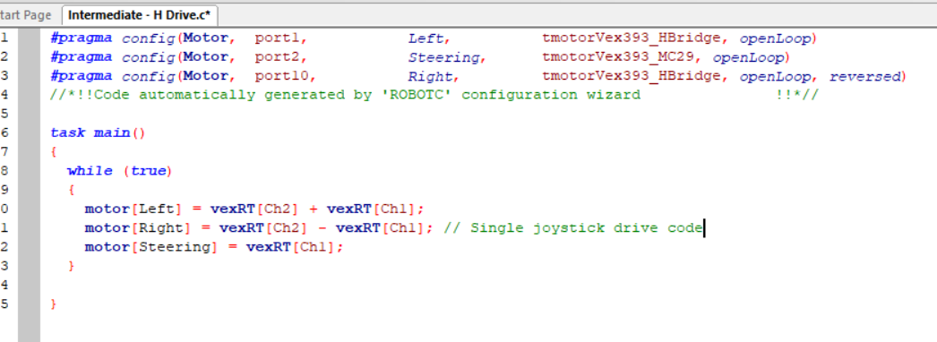
Now add the single joystick drive code for the Left and Right motors. Again check back to previous PowerPoints for explanation of single joystick drive code.
Download this code and test it! The robot should turn and drive back and forth properly.

Slide 7
start
Now onto strafing. You can either use the left joystick to strafe, or a couple of buttons.
It’s important to know that the four other wheels need to stop (or move against each other) for strafing to work. So we need to implement if statements to stop the other wheels when the conditions for strafing are met.
Here’s the flowchart:
Strafe?
Loop back forever
YES
NO
Stop other wheels, only move the middle one.
Normal drive

Slide 8
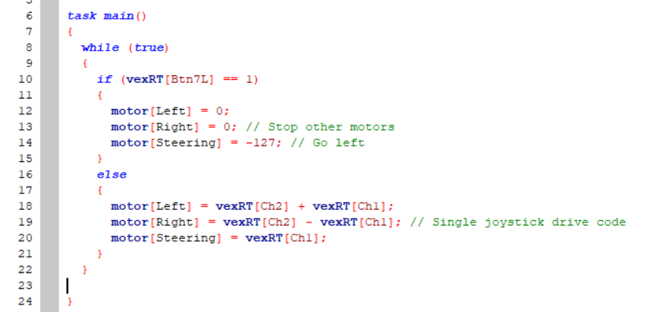
Here’s how to do one button for strafing left. Try this out and test it before you code for another button that makes the robot strafe right.
Notice how the “normal drive” part is in the else statement, which closely follows the flow chart on the last slide. It’s a common misconception that drive cannot be in if statements – that’s just wrong. Thinking your logic through and making flowcharts will help determine whether you need something in the if/else statements.

Slide 9
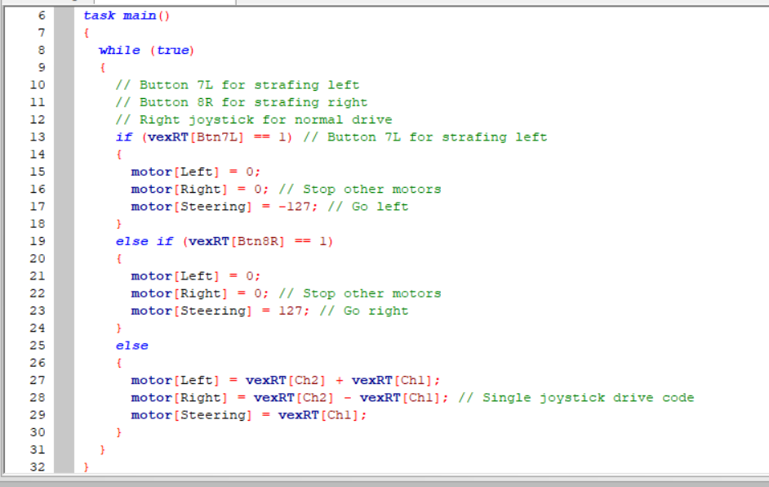
Here’s the sample code with both buttons. It doesn’t matter which buttons you use, but your driver probably cares :D. It’s also helpful to comment what the controls are for quick referencing.

Slide 10
Some drivers may prefer to strafe with the left joystick (I don’t drive things so Idk but just in case). It’s essentially the same thing but changing the condition from “button pressed” to “joystick held”.
Almost all joysticks get “sticky” – that is, they are not perfectly at (0,0) position at rest. So when we are coding the “joystick held” condition, we need to account for that.
Usually, when the absolute value (fancy word for number without a sign) of the joystick value is greater than 15, it shouldn’t be sticky and is considered held.
“joystick held”
“joystick held”
-15
15
“joystick not held” (accounting for stickiness)

Slide 11
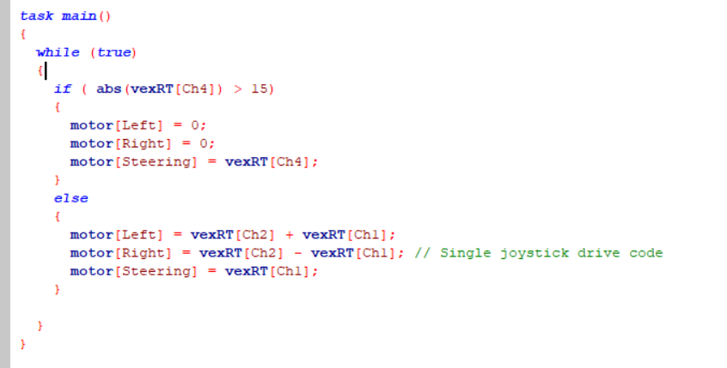
This is the final code for H-Drive with a joystick for strafing. Feel free to change up the channels according to your driver’s preferences.
abs(number) is to take the absolute value of that number.

Slide 12
Thanks for viewing as always and hope this is useful for you. I will be doing less “step by step” code comparing to the basics series from now on. But I will try to incorporate more charts and pictures to show my thoughts, as well as things I’ve found useful in my past coding experience. All the examples in this intermediate series are robot designs / code challenges I encountered and found really useful and educational. Hope that’s the case with you too.
For questions and advice, please email alicexxx0516@gmail.com.
Good luck with your code!! (And for those club members, good luck to your upcoming competitions!
2018.03.29
Alice X.

